Slide 1
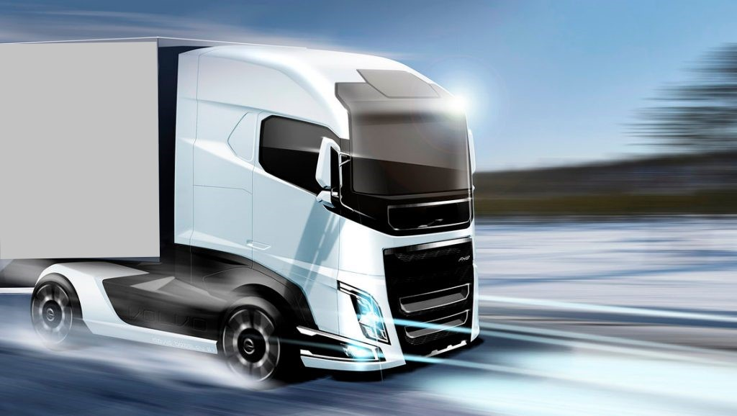
EUROWAG
Technical Data
connections and vehicles

Slide 2
Technical Data
connections and vehicles
This presentation is intended to support the installation of EW devices (Vetronics v820 and EVA OBU v850)
With a wide variety of brands and vehicles, it is necessary to be aware of the type of connection to be made.
This guide serves to inform in a general context of the type of connection to be made with FMS and in vehicles that do not have this type of connection.
Depending on the service contracted by the customer, the installation method is also different.
There are two types of installation on EW devices, fixed installation and installation via cigarette lighter connector.

Slide 3
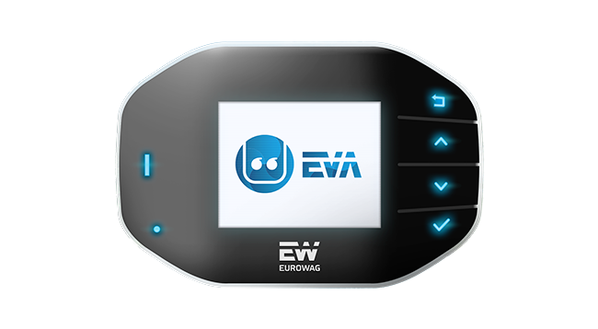
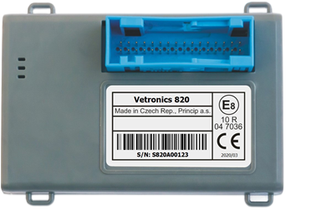
Vetronics 820 / Eva obu 850
connection modes

Slide 4
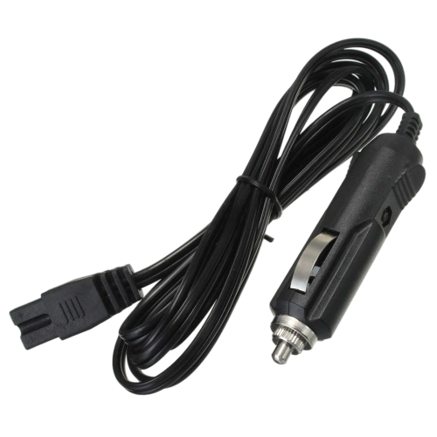
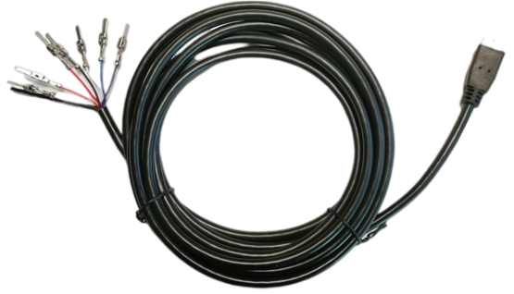
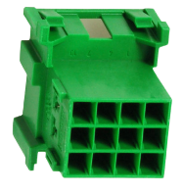
Eva obu 850
connection modes
EVA OBU 850 can be connected in two ways, by fixed installation or by connection with a cigarette lighter plug.
Fixed installation, if any, preferably on the vehicle's FMS connector.
If the vehicle does not have an FMS connector, it must be connected to the fuse panel and the respective CAN lines
The cigarette lighter cord can be cut and the equipment plugged directly into the fuse box.

Slide 5
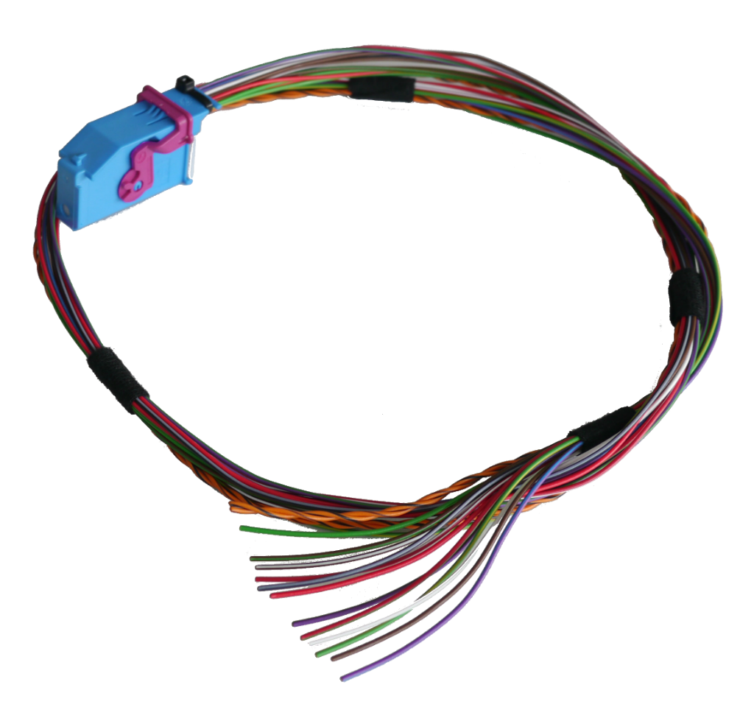
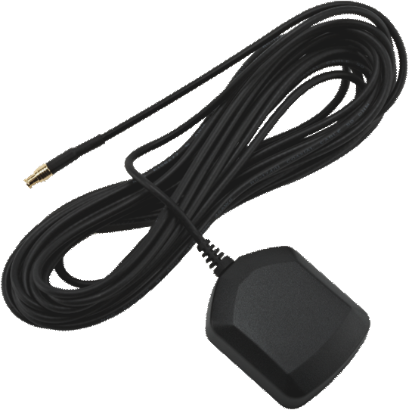
Vetronics 820
connection modes
Vetronics 820 is only installed in a fixed way, with preferential connection to the FMS connector, if the vehicle does not have an FMS connector, connect to the fuse box and respective CANBUS lines

Slide 6
RECOMMENDED INSTALLATION LOCATIONS PER TRUCK BRAND
The technical engineer remains responsible at all times for the correct installation and connection of the
hardware.
Always check all functionalities after each installation. EUROWAG cannot be held responsible for any possible
damage /interruption ensuing from the correct or incorrect following of the recommendations as listed in this
presentation.
WHAT IS AN FMS INTERFACE?
FMS gateway refers to an interface that helps to release technical information about a vehicle
to the back office. Leading truck manufacturers have agreed to use one, single standard for delivering
information from their vehicle CAN Bus to third parties: the FMS standard. By fitting an FMS interface / gateway
into a vehicle, the CAN Bus technology is linked to the telematics solution of the fleet management system (FMS)
This allows the carrier’s back office to read out and interpret all the technical details.

Slide 7
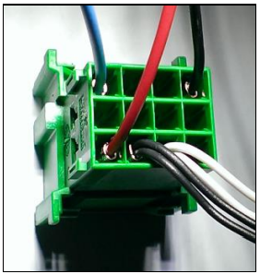
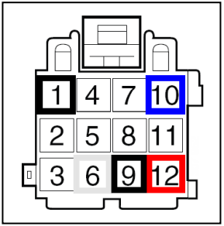
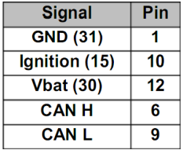
RECOMMENDED INSTALLATION LOCATIONS PER TRUCK BRAND
FMS connector connections and respective connecting pins:
* Please note that only on the Vetronics 820 device it is necessary to connect the ignition key (K15)
as on the EVA OBU V850 device this connection is not necessary as it is detected through the connection
to the tachograph (D8).

Slide 8
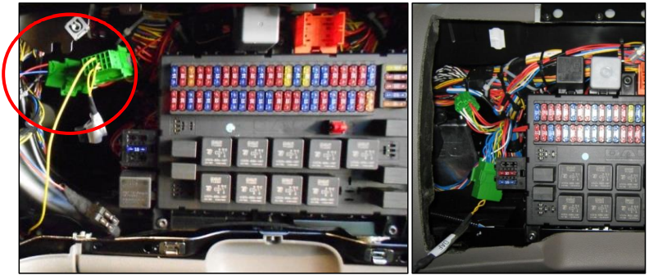
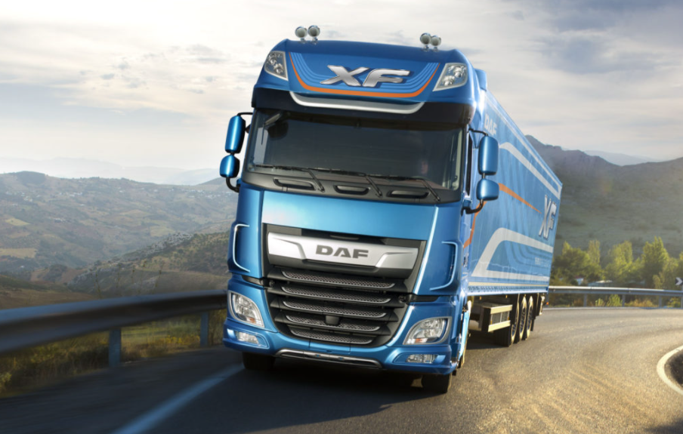
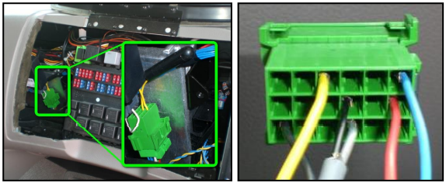
WHERE TO FIND THE FMS INTERFACE ON MY TRUCK :
DAF XF
-Passenger side, left side of fuse box

Slide 9
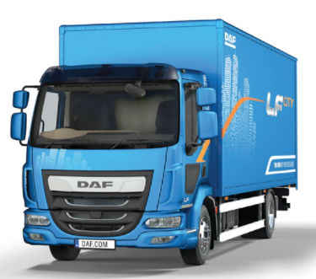
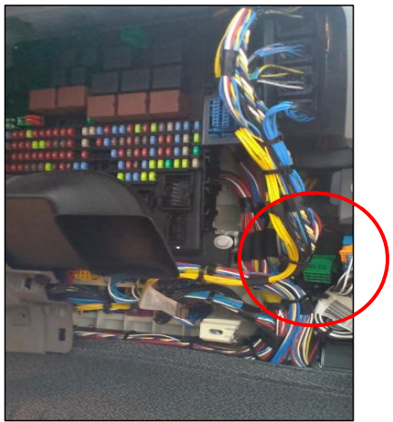
WHERE TO FIND THE FMS INTERFACE ON MY TRUCK :
DAF LF EURO 6
-passenger side, on the right side of the fuse box

Slide 10
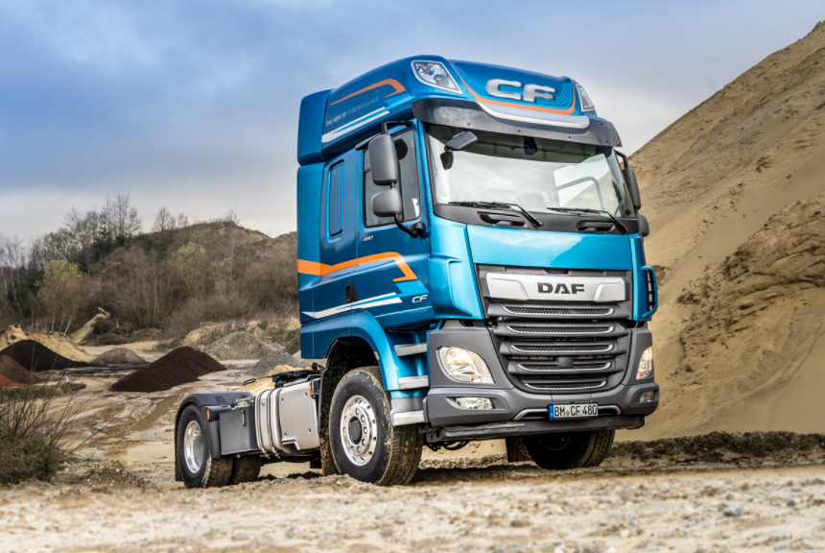
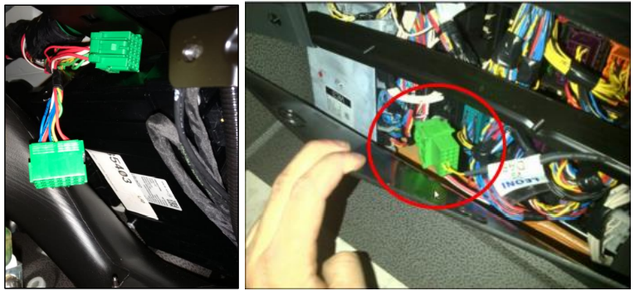
WHERE TO FIND THE FMS INTERFACE ON MY TRUCK :
DAF CF
-Passenger side, under the fuse box

Slide 11
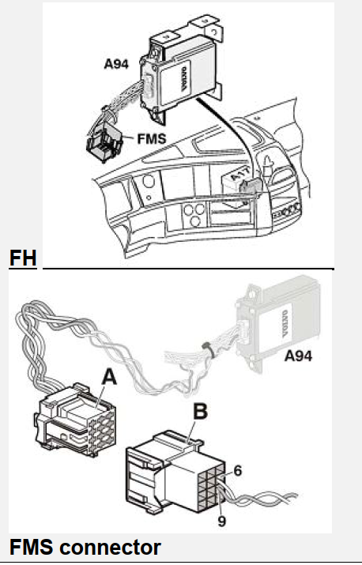
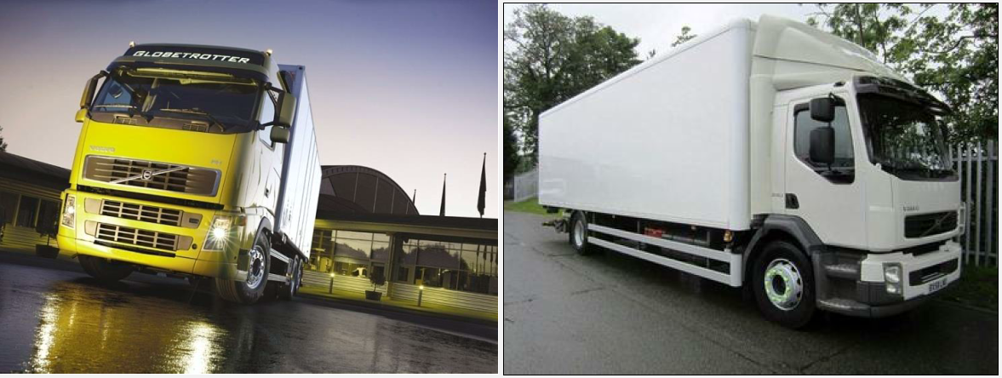
WHERE TO FIND THE FMS INTERFACE ON MY TRUCK :
VOLVO FH-FM E4
Remove the fuse holder cover and remove the screws holding the cup
holder, fms connector behind the cup holder

Slide 12
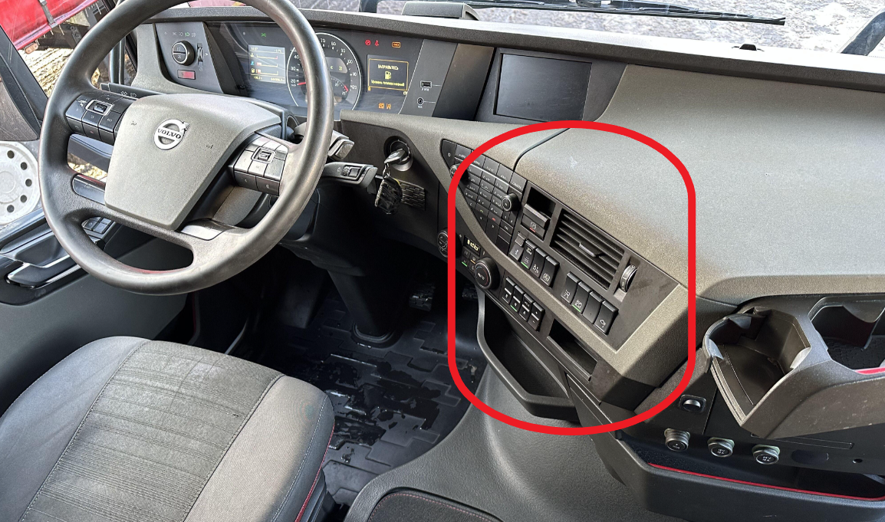
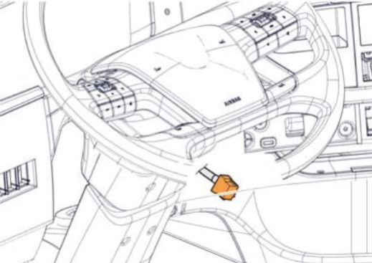
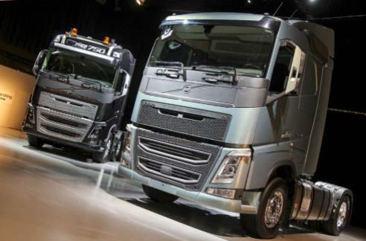
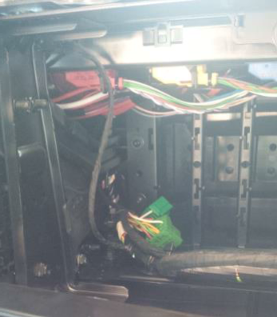
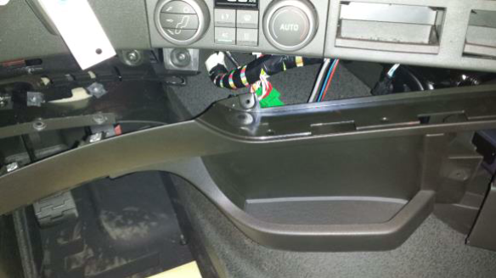
WHERE TO FIND THE FMS INTERFACE ON MY TRUCK :
VOLVO NEW FH-FM-FL
It can also be found under the fuse board.

Slide 13
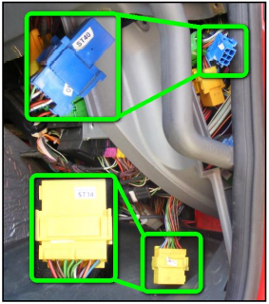
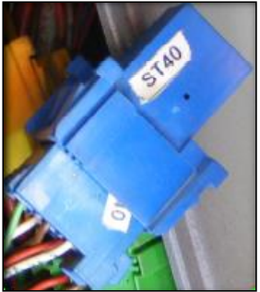
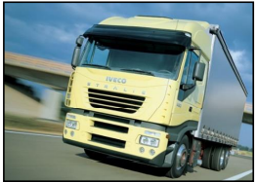
WHERE TO FIND THE FMS INTERFACE ON MY TRUCK :
Iveco Stralis I
Passenger side, on the right side of the fuse box.
Somewhere above connector ST14, you can find the blue connecter ST40. The FMS connections should
be made here.
The pin numbers of the FMS wires can change. So be sure to connect to the correct wire colors.

Slide 14
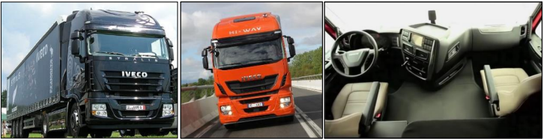
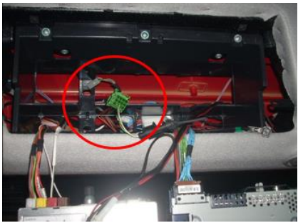
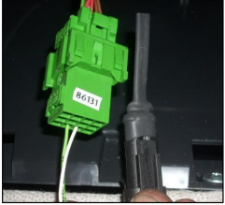
WHERE TO FIND THE FMS INTERFACE ON MY TRUCK :
Iveco Stralis II & Hi-Way
The connector can be found behind
the radio. It is housed in one of the
compartments in DIN format,
located above the driver's side sun visor

Slide 15
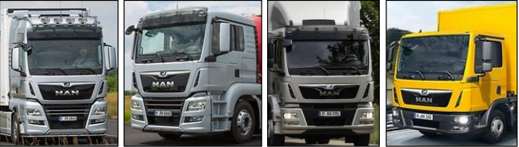
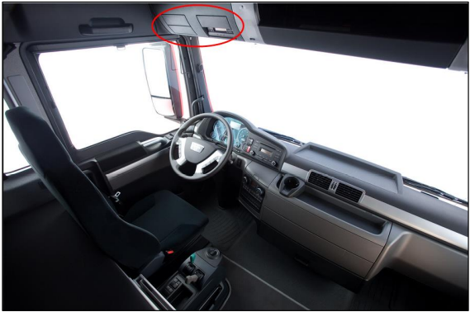
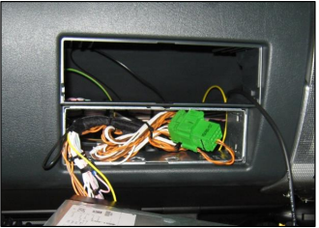
WHERE TO FIND THE FMS INTERFACE ON MY TRUCK :
MAN TGX, TGS, TGM, TGL
Can be found on the right side of the tachograph,
behind the cover.

Slide 16
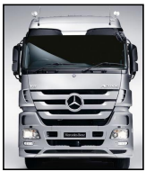
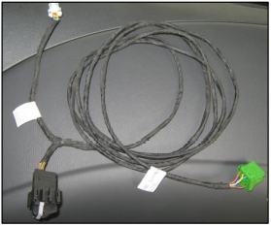
WHERE TO FIND THE FMS INTERFACE ON MY TRUCK :
MERCEDES ACTROS (MP 1,2,3) Euro 3/4/5
Since November 2011, the Actros is delivered with an active Fleetboard.
The customer needs to order the Y-cable that is connected to the Fleetboard. The “FMS router function”
must be activated in the Fleetboard by MB Germany.
This specific cable must be ordered from and installed by Mercedes-Benz. For further information, please
consult the specific truck installation guides (TIG).
If available, the FMS connector can be found:
- Behind the radio.
- Behind the center of the dashboard.

Slide 17

WHERE TO FIND THE FMS INTERFACE ON MY TRUCK :
Mercedes New ACTROS (MP4), ANTOS, ATEGO, AROCS Euro 5-6
Since November 2011, the Actros is delivered with an active Fleetboard.
The customer needs to order the Y-cable that is connected to the Fleetboard. The “FMS router function”
must be activated in the Fleetboard by MB Germany.
This specific cable must be ordered from and installed by Mercedes-Benz. For further information, please
consult the specific truck installation guides (TIG).

Slide 18
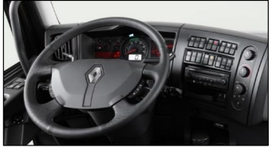
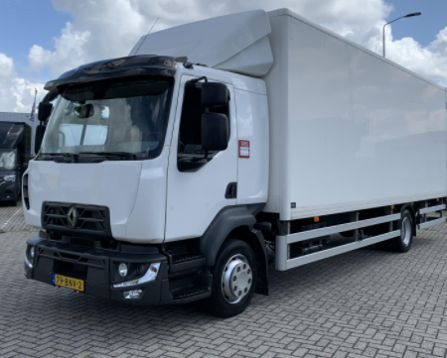
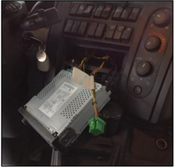
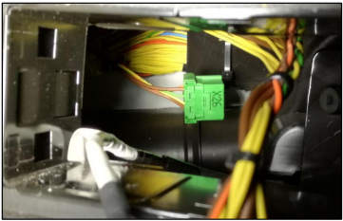
WHERE TO FIND THE FMS INTERFACE ON MY TRUCK :
Renault D
Behind the radio panel, you should find FMS connector X26

Slide 19
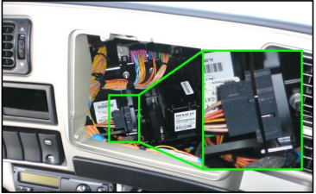
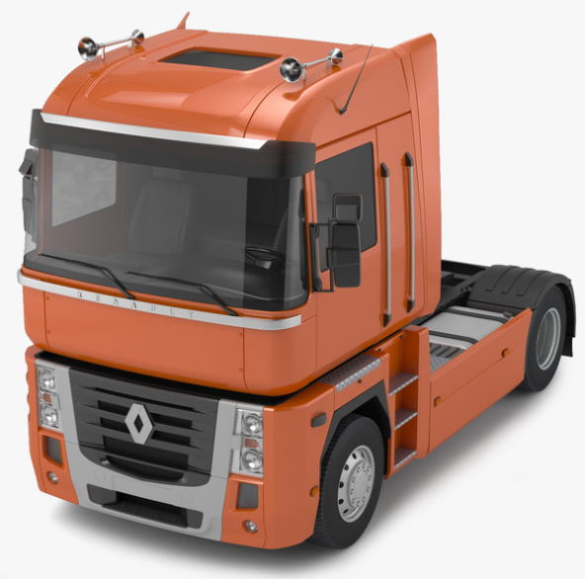
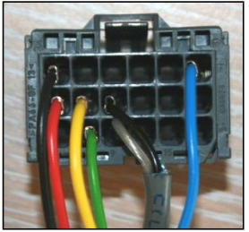
WHERE TO FIND THE FMS INTERFACE ON MY TRUCK :
RENAULT MAGNUM DXI & E-TECH
The grey FMS connector can be found behind the
cup holder on the right side of the driver. All
connections can be made there.

Slide 20
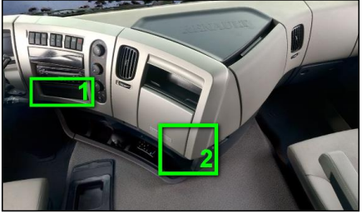
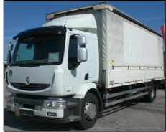
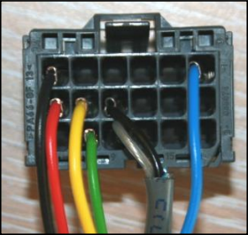
WHERE TO FIND THE FMS INTERFACE ON MY TRUCK :
RENAULT MIDLUM DXI
The location of the grey FMS connector
depends on the cab model and the
production date.
1. Behind the cover plate underneath the
radio.
2. Behind the bottom part of the
dashboard. To reach it, dismount the
glove box

Slide 21
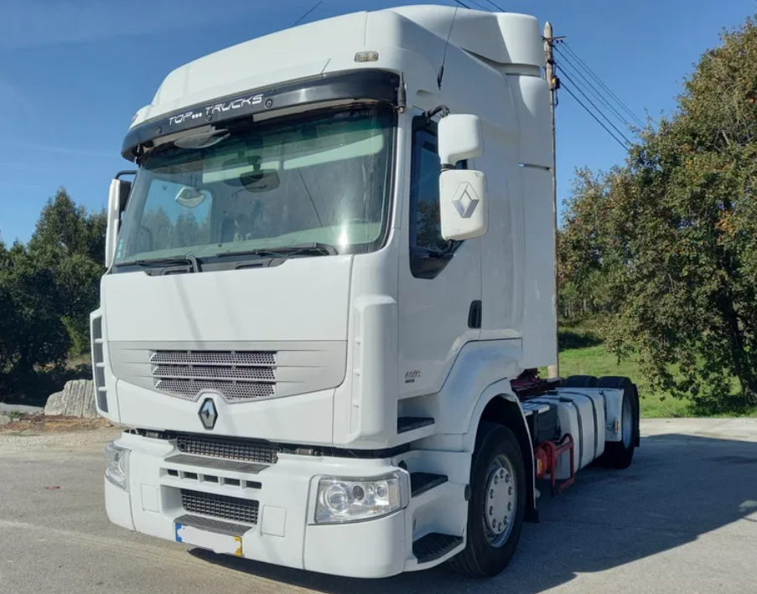
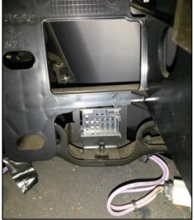
WHERE TO FIND THE FMS INTERFACE ON MY TRUCK :
RENAULT MIDLUM DXI
The location of the grey FMS connector
depends on the cab model and the
production date.
1. Behind the cover plate underneath the
radio.
2. Behind the bottom part of the
dashboard. To reach it, dismount the
glove box (2 screws on the inside).

Slide 22
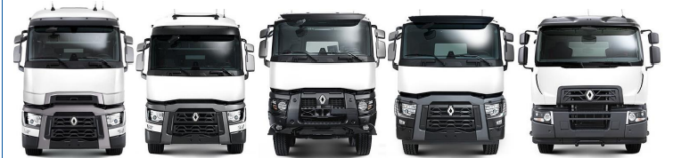
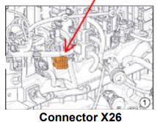


WHERE TO FIND THE FMS INTERFACE ON MY TRUCK :
Renault T K C
Can be found behind the main panel.

Slide 23


WHERE TO FIND THE FMS INTERFACE ON MY TRUCK :
Renault T C K 2021
Can be found over the tachograph.

Slide 24




WHERE TO FIND THE FMS INTERFACE ON MY TRUCK :
SCANIA R-G-P Series
Connector C137 can be located underneath the fuse board.

Slide 25



WHERE TO FIND THE FMS INTERFACE ON MY TRUCK :
SCANIA P-G-R-S Series
Connector C137 can be located behind the fuse board
(take out the air tube).

Slide 26




WHERE TO FIND THE FMS INTERFACE ON MY TRUCK :
FORD F-MAX
Above the conductor, on the left side of the
tachograph

Slide 27


CONNECTION TO THE CAN BUS VIA CAN INTERFACE (CANSNIFFER)
In case the vehicle does not have a FMS connector, the CAN
interface can be used to connect to the vehicle CAN Bus
(cansniffer).
A contactless CAN reader is used to connect the CAN-BUS in the vehicle, see below.
The CAN-BUS wires must be inserted into the slots at the top of the reader
(CAN_L - upper groove, CAN_H - lower groove), click and secure with a cable tie.

Slide 28

Connection to truck CAN signal
Here you can see some examples of vehicles and their canbus lines according to the brand and model.

Slide 29

Connection to truck CAN signal
DAF XF – CF – LF (EURO 5) On the lower left side of
the fuse box, the CAN Bus distribution block can be
found.
Connect the TYPE 1 CAN interface to any of the
blue and yellow wires.
- CAN HIGH: BLUE
- CAN LOW: YELLOW

Slide 30

Connection to truck CAN signal
DAF XF – CF – LF (EURO 6) Find the green 56k connector behind the lower dashboard panel on the passenger side.
-CAN HIGH: RED
-CAN LOW: YELLOW

Slide 31


Connection to truck CAN signal
IVECO Stralis I / II / Hi-way On the backside of the fuse board, you can find connector J2, where you can connect the TYPE 1 CAN interface.
CAN HIGH: WHITE - PIN 3 Iveco
CAN LOW: GREEN - PIN 4 Iveco

Slide 32

Connection to truck CAN signal
MAN TGA - TGL - TGM (< 2007) On the left side of the fuse board, you can find the white connector A 403X1. Here, you can connect the TYPE 1 CAN interface to the BLUE - WHITE and BLUE - RED wires:
CAN HIGH: BLUE - RED
CAN LOW: BLUE - WHITE

Slide 33

Connection to truck CAN signal
MAN TGX - TGS - TGL - TGM On the left side of the fuse board, you can find the black connector A 402X1. You can connect the CAN wires here:
CAN HIGH: BLUE - RED
CAN LOW: BLUE - WHITE

Slide 34

Connection to truck CAN signal
SCANIA R-G-P Series Connector C481 (YELLOW / WHITE wires) can be found on the right side of the fuse board. Take the connector out of its holder and open it.
CAN HIGH: all YELLOW wires
CAN LOW: all WHITE wires

Slide 35

Connection to truck CAN signal
MERCEDES Actros (MP 1 - 2 - 3) Connect the CANcliQ to the YELLOW and BLUE wires of connector X11. The yellow wires (upper row) are all CAN LOW. The blue wires (lower row) are all CAN HIGH.
CAN HIGH: BLUE
2. CAN LOW: YELLOW

Slide 36

Connection to truck CAN signal
MERCEDES Actros (MP 4) / Antos / Arocs / Atego Find the connector with the green and blue twisted wires:
1. CAN HIGH: BLUE
2. CAN LOW: GREEN

Slide 37

Connection to truck CAN signal
MERCEDES Axor II / Atego II Connect the CANcliQ to the yellow and blue wires of the connector on the left side below the fuse board. The BLUE wires (right row) are all CAN HIGH. The YELLOW wires (left row) are all CAN LOW.
1. CAN HIGH: BLUE
2. CAN LOW: YELLOW

Slide 38

Connection to truck CAN signal
IVECO HiWay (> 2016) Remove the lower dashboard cover. The CAN wires are located near the lower ECU. The blue connector can be found on the right side of the ECU.
CAN HIGH: WHITE
2. CAN LOW: GREEN

Slide 39

Connection to truck CAN signal
SCANIA R-S-G-P (EURO 6 – 2018) Remove the dashboard cover and fusebox to find the wiring loom on the left side that contains a yellow and white twisted pair of wires with a grey ground wire.
CAN HIGH: YELLOW
2. CAN LOW: WHITE

Slide 40


Connection to truck CAN signal
VOLVO FH-FM E4 : Open the dashboard by removing the top cover. Under the fuse box, green 5 pin connector .
1.CAN HIGH: YELLOW
2.CAN LOW: GREEN

Slide 41

Connection to truck CAN signal
VOLVO FH-FM EURO 6 (>2013) Open the dashboard by removing the top cover. Find the twisted green and yellow wires on the horizontally placed connector in the top left corner of the fuse box.
CAN HIGH: YELLOW
2. CAN LOW: GREEN

Slide 42

Connection to truck CAN signal
Renault T - K – C EURO 6 Use the 2nd pair from the left.
CAN HIGH: YELLOW
2. CAN LOW: GREEN

Slide 43

Connection to truck CAN signal
VOLVO FE-FL EURO 6 (>2013) The connection is located on the passenger side, to the right of the fuse box.
CAN HIGH: YELLOW
2. CAN LOW: GREEN
Use the YELLOW and GREEN wires from the 4-pin connector.

Slide 44


Connection to truck CAN signal
RENAULT Magnum DXI The VECU can be found behind the cup holder.
The connector is directly below it.
CAN HIGH: BROWN (J1708)
CAN LOW: ORANGE (J1708)
CAN HIGH: ORANGE (CAN)
CAN LOW: GREEN (CAN
It can also befound behind
the fuse board.

Slide 45

Connection to truck CAN signal
RENAULT Midlum/Premium DXI VOLVO FL (≤ 2012) The VECU can be found behind the panel on the right side.
CAN HIGH: BROWN (J1708)
CAN LOW: ORANGE (J1708)
CAN HIGH: ORANGE (CAN)
CAN LOW: GREEN (CAN)

Slide 46

Connection to truck CAN signal
VOLVO FH-FM type 2 (≤ 2012) Underneath the fuse board, you can find the VECU. Remark: If there are 2 similar connectors, always take the one closest to the front of the truck.
CAN HIGH: ORANGE
CAN LOW: GREY
CAN HIGH: YELLOW
CAN LOW: GREEN

Slide 47

Technical Data
connections and vehicles
Hope this manual is useful and that it helps in the installation of our equipment.
In case you need help, you can contact via email: paulo.cerqueira@eurowag.com

